Slide 1
Gender stereotypes

Slide 2
Learning objectives and outcomes
Learning objective:
To critically assess and challenge gender stereotypes and understand how these can be harmful in relationships
Learning outcomes:
I can explain what gender stereotypes are and how they can be harmful
I can describe the effect gender stereotypes can have on relationships
I can evaluate ways of challenging gender stereotypes

Slide 3
Ground rules
Use language that will not offend or upset anyone.
When you give an opinion, try to explain your reasons.
Listen to the views of others and show respect.
If you disagree, comment on what was said, not the person who said it.
Do not share personal information about other people.
If you’re worried about something that has happened to you or a friend, talk to a member of staff or an adult you trust after the session.
If a member of staff becomes aware of a risk to a young person’s safety, this information may need to be shared.

Slide 4
Gender expectations
Are boys and girls expected to behave differently?
Are boys and girls expected to act differently in relationships?
Are boys and girls expected to think differently about their appearance?
Are boys and girls expected to express their feelings and emotions differently?

Slide 5
Harms of gender stereotypes
Expectations about how boys and girls ‘should’ be are often called gender stereotypes.
Gender stereotypes can be harmful to everyone, even when they might look to be fine or positive on the surface.
This is because:
They can stop people being and expressing themselves.
Lots of people go along with them without questioning or challenging them.
They can cause problems in relationships.

Slide 6
How can gender stereotypes harm relationships?

Slide 7
Gender stereotypes in relationships

Slide 8
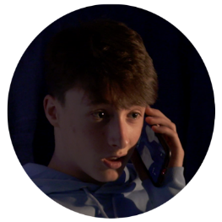
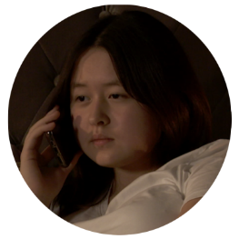
Gender stereotypes in relationships
How have Finn and Zara benefitted from talking to each other about how they feel?
Finn
Zara

Slide 9
Challenging gender stereotypes
It can be difficult to challenge gender stereotypes for a number of reasons:
Continually seeing and hearing messages that tell people to think and act that way (these might be at home, at school, online or on TV)
People feeling (or knowing) that they’ll be teased or bullied for going against them
People thinking that everyone else buys into or believes them

Slide 10
What could help people to challenge gender stereotypes in themselves or others?

Slide 11
What can help people to challenge gender stereotypes?
Talking about them with friends and family – what do other people really think?
Recognising and challenging their own thoughts or behaviour
Calling out gender stereotypical behaviour (when it is safe to do so)
Thinking critically about social media and TV programmes or films that communicate these messages (Asking themselves what they think about it. Is that true or real?)

Slide 12
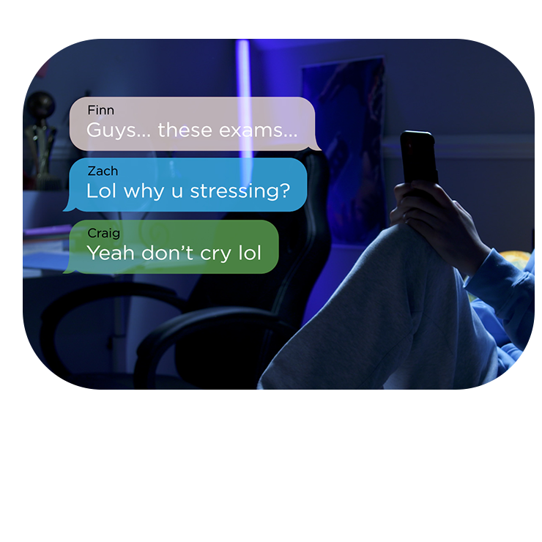
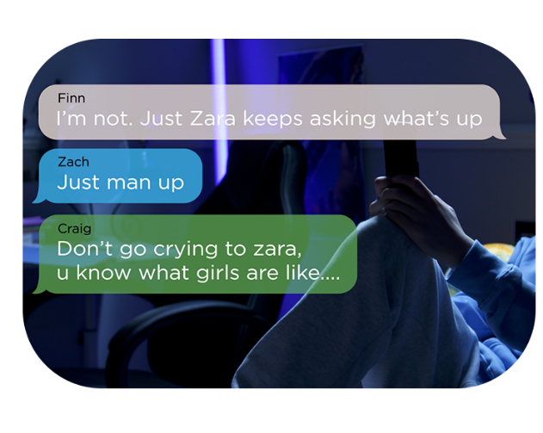
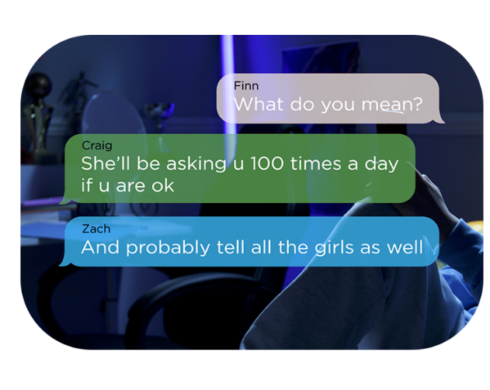
Responding to gender stereotypes
In the film, Finn’s friends displayed harmful attitudes about how boys ‘should’ act in relationships.
Write a new text from Finn’s friends that show how they should have responded once Finn expressed his feelings.

