Slide 1
Principles of healthy sexual experiences

Slide 2
Learning objectives and outcomes
Learning objective:
To understand the core principles that should be present between two people during positive and healthy sexual experiences
Learning outcomes:
I can identify the principles of healthy sexual experiences
I can explain how these principles can be demonstrated in healthy sexual experiences, online and offline
I can describe what someone could do if the principles of healthy sexual experiences were not being followed

Slide 3
What do we mean by ‘sexual experiences’?
Sexual experiences or sexual activity refers to any way that people connect with each other sexually.
This can be online and in person and includes:
Kissing
Sharing sexual messages, photos and videos
Sexual touching
Oral sex
Vaginal or anal sex
During the lesson, we will only be talking about sexual experiences between two people.

Slide 4
Ground rules
Use language that will not offend or upset anyone.
When you give an opinion, try to explain your reasons.
Listen to the views of others and show respect.
If you disagree, comment on what was said, not the person who said it.
Do not share personal information about other people.
If you’re worried about something that has happened to you or a friend, talk to a member of staff or an adult you trust after the session.
If a member of staff becomes aware of a risk to a young person’s safety, this information may need to be shared.

Slide 5
Scenario
RS: Sam just told me about Saturday night. Did Alex say yes then?
LM: I dunno. Alex was pretty drunk. But they really like each other so I’m sure they both wanted to.
RS: I’m not sure. Sam didn’t enjoy it and feels a bit weird about talking to Alex now.
Do you think Sam and Alex consented to sexual activity?
Should both people have to enjoy sexual activity?
How might someone be able to tell if another person is comfortable with sexual activity?

Slide 6
What does consent mean?
Consent, in simple terms, means to agree to something.
When applied to sex, sexual consent means to agree to engage in a sexual activity, with full understanding and capacity.
Capacity
Someone doesn’t have full capacity to consent if they:
Are asleep or unconscious
Are under the influence of alcohol or drugs
Cannot speak or communicate clearly
Don’t understand what is happening
Are under 16 years old
Consent can be given with words as well as body language.
Consent to sexual activity can be withdrawn at any time.

Slide 7
Signs of consent
Consent
Saying ‘yes’
Saying that the sexual activity is enjoyable
Eye contact
Being relaxed
Touching or kissing
Being responsive
Non-consent
Saying ‘no’
Avoiding eye contact
Crying or shaking
Flinching
Resistance
Silence or stillness
Rigid or tense body

Slide 8
Consent and the law
In UK law, the age of consent is 16 years old.
This means anyone below 16 cannot give consent even if they are saying yes to sexual activity.
For sending nude or semi-nude images and videos this is 18 years old.
Sexual activity without consent is always illegal.

Slide 9
Core principles of healthy sexual experiences
Consent
Respect
Honesty
Enjoyment

Slide 10
Both people only do sexual activities which they both want to do; without any force, pressure or persuasion. Both people have full capacity to consent to sexual activity. Both people feel positively about sexual activity and have no negative emotions about it. It is always ok for either person to withdraw at any stage from sexual activity, and both respect this and stop.
1
Respect
A
Before, during and after sexual activity, both care about and respond to their own and the other person’s feeling. Each person’s body, boundaries and feelings are as important as the others. Neither person sees or treats the other as of less worth than themselves and each listen to what is being communicated, both verbally and non-verbally.
2
Enjoyment
B
There isn’t any deception, trickery, or withholding of relevant information. This includes being honest about: who you are – not lying or embellishing to ‘get someone into bed’; any health issues – including sexually transmitted diseases; and what both people want from sexual activity – including which sexual activities each person is ready for.
3
Consent
C
Both people should be enjoying the sexual activity and checking in with the other person about their feelings.
4
Honesty
D

Slide 11
Before, during and after sexual activity, both care about and respond to their own and the other person’s feeling. Each person’s body, boundaries and feelings are as important as the others. Neither person sees or treats the other as of less worth than themselves and each listen to what is being communicated, both verbally and non-verbally.
1
Respect
B
Both people should be enjoying the sexual activity and checking in with the other person about their feelings.
2
Enjoyment
D
Both people only do sexual activities which they both want to do; without any force, pressure or persuasion. Both people have full capacity to consent to sexual activity. Both people feel positively about sexual activity and have no negative emotions about it. It is always ok for either person to withdraw at any stage from sexual activity, and both respect this and stop.
3
Consent
A
There isn’t any deception, trickery, or withholding of relevant information. This includes being honest about: who you are – not lying or embellishing to ‘get someone into bed’; any health issues – including sexually transmitted diseases; and what both people want from sexual activity – including which sexual activities each person is ready for.
4
Honesty
C

Slide 12
Which principles aren’t being followed?
1. Jules is at a house party, chatting to Kat, who is flirting with her. Jules picks up (correctly) that Kat is interested in her. Jules is not attracted to Kat but is thinking about kissing her and seeing how far they might go, because Kat is really popular.
2. When Zakia and Luca were going out, Zakia sent Luca a nude. A few months later, Zakia ended the relationship with Luca. Luca is thinking about showing his friends Zakia’s nude because he feels bitter and wants to somehow ‘get back’ at her.
3. Glen and Charlie are flirting at a house party. They are both very drunk, at one point Charlie falls over and starts talking about wanting to go home. Glen feels that if he doesn’t make a move now, the opportunity will be missed.
How could someone support a friend who had a sexual experience where the principles weren’t followed by the other person?

Slide 13
Healthy attitudes towards sharing nudes
Principles of healthy sexual experiences should be present in online situations too.
Notes:
If video does not play on your device, use Vimeo version - : https://vimeo.com/591596351/b95bdb5f6c.

Slide 14
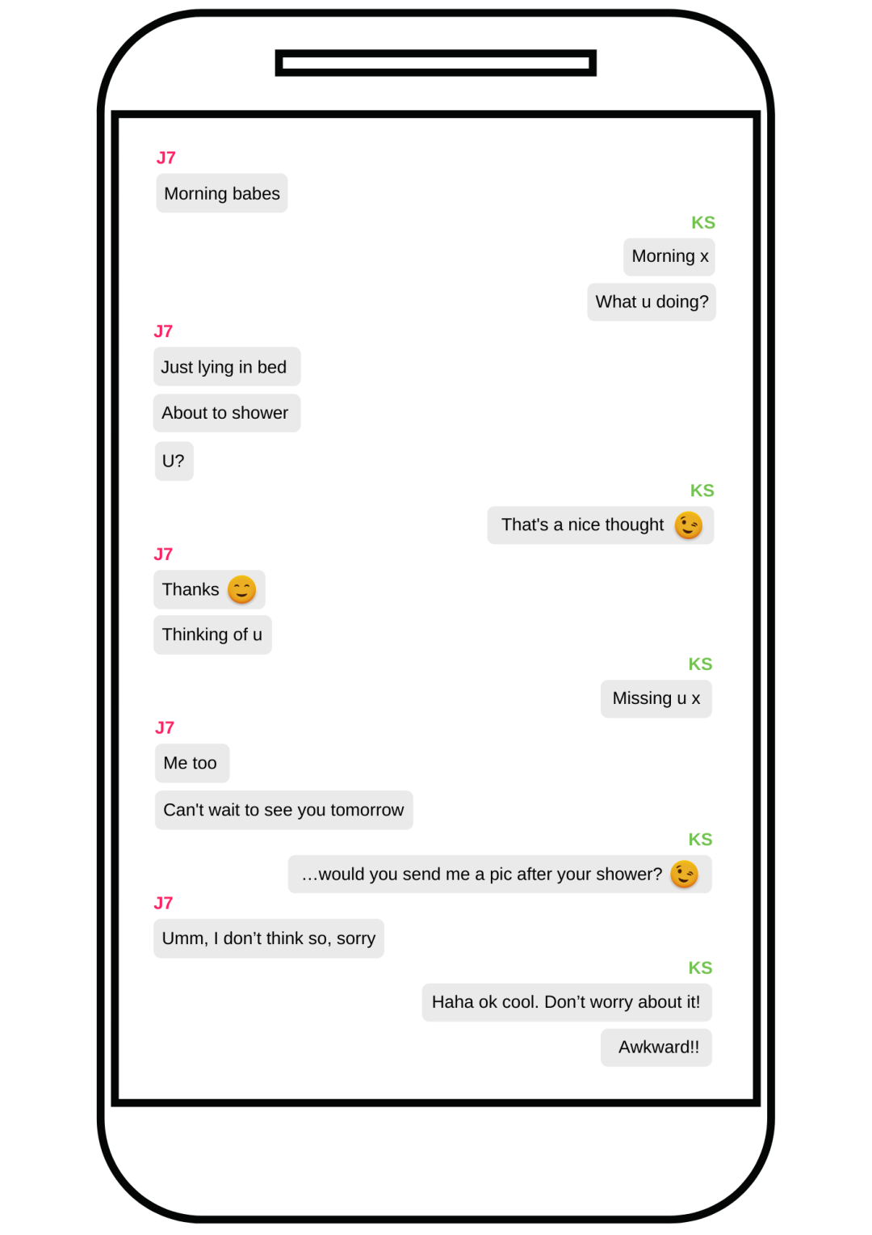
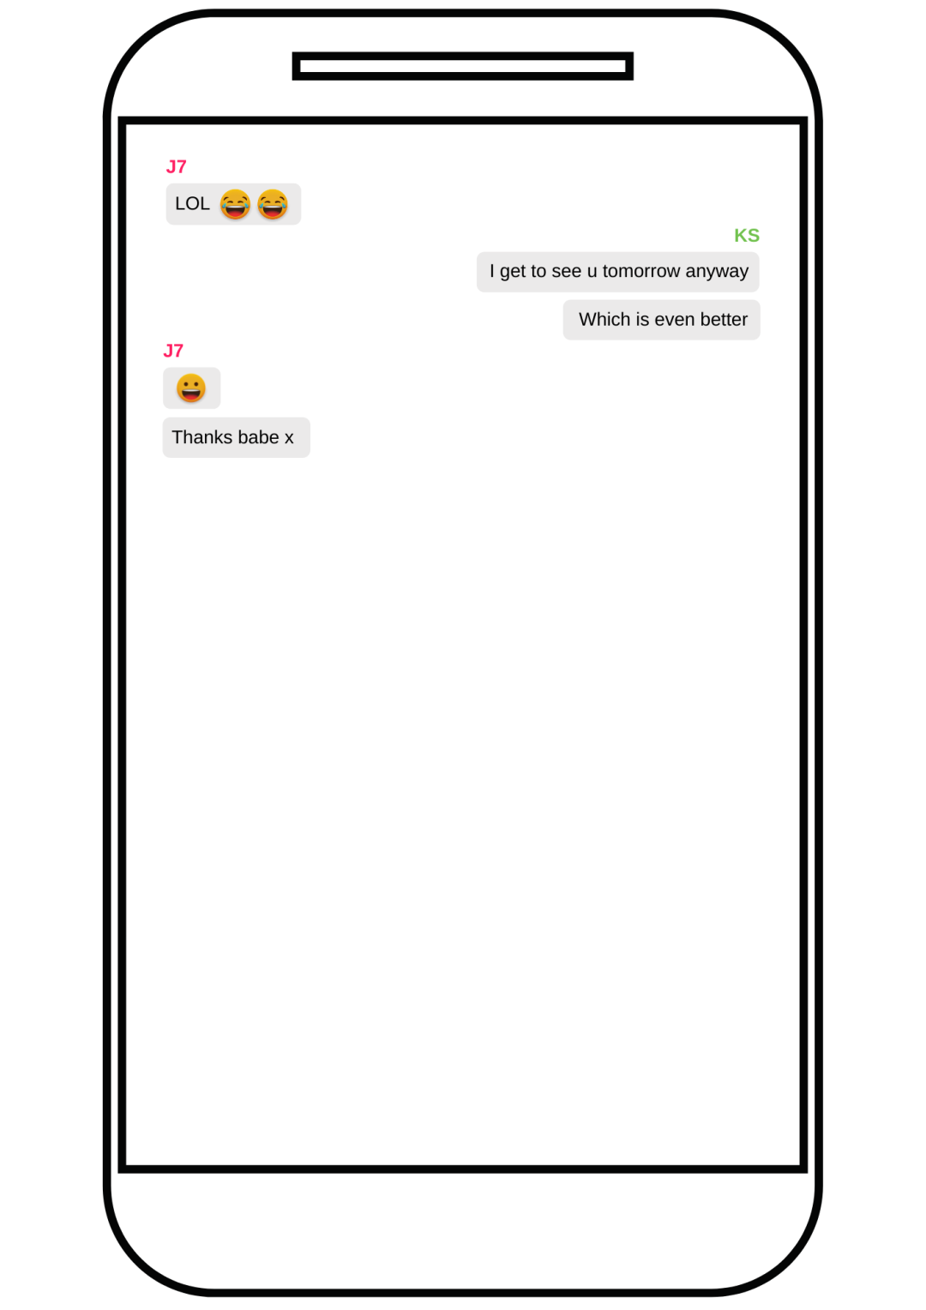

Slide 15
Scenario
Do you think Sam and Alex consented to sexual activity?
Should both people have to enjoy sexual activity?
How might someone be able to tell if another person is comfortable with sexual activity?
How could RS and LM support their friend Alex?
RS: Sam just told me about Saturday night. Did Alex say yes then?
LM: I dunno. Alex was pretty drunk. But they really like each other so I’m sure they both wanted to.
RS: I’m not sure. Sam didn’t enjoy it and feels a bit weird about talking to Alex now.

