Slide 1
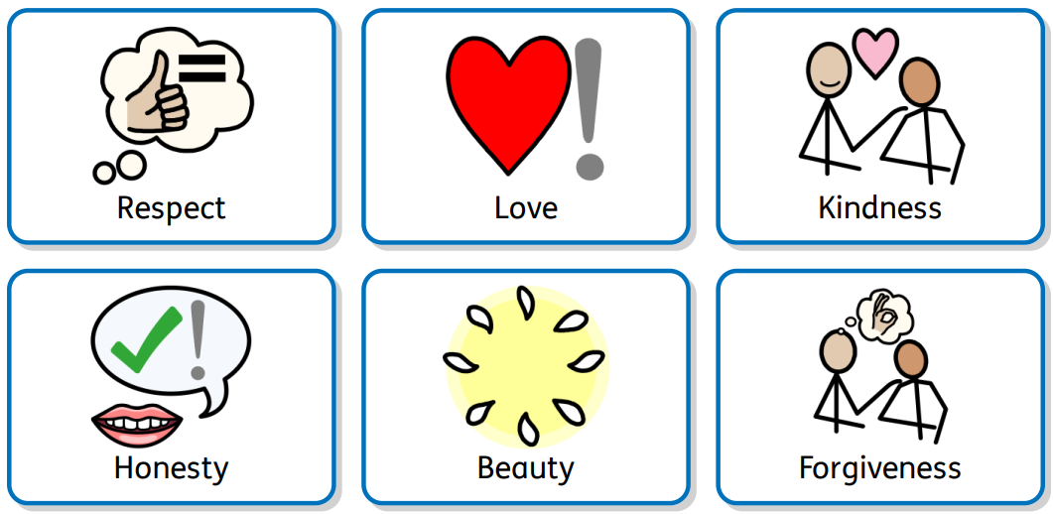
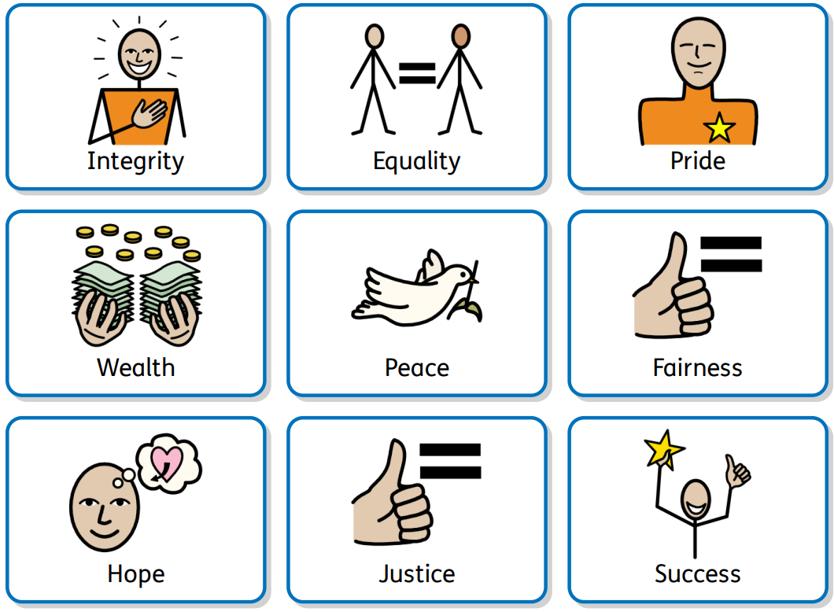
Handout: Internal and external value symbols (alternative activity)
Widgit Symbols © Widgit Software 2002 - 2022
My values

Slide 2
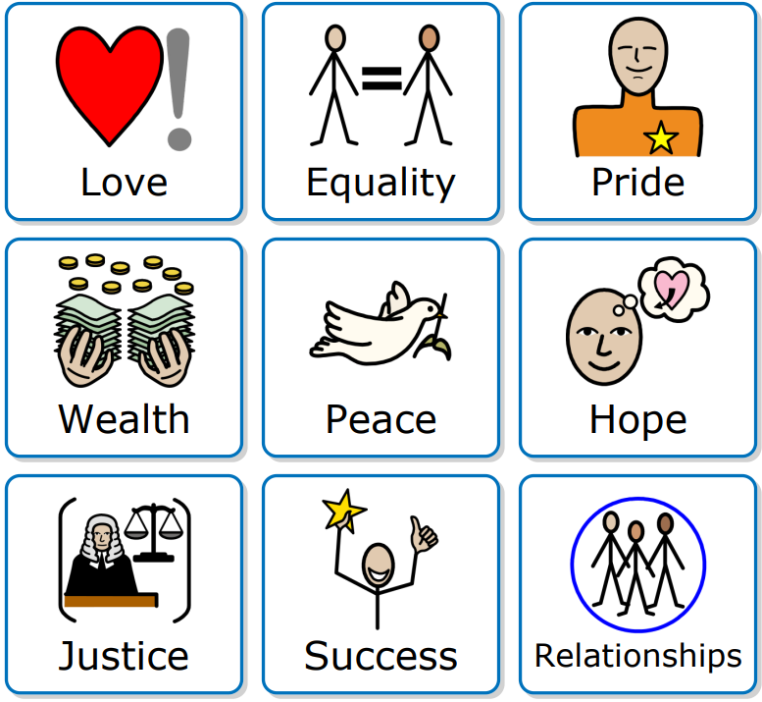
Handout: My values symbols (optional)
Widgit Symbols © Widgit Software 2002 - 2022
My values

Slide 3
Handout: My values symbols (optional)
Widgit Symbols © Widgit Software 2002 - 2022
My values

Slide 4
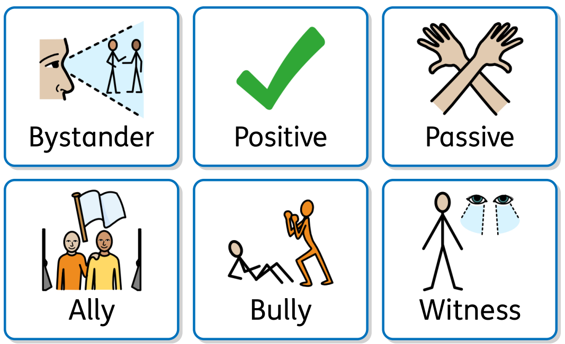
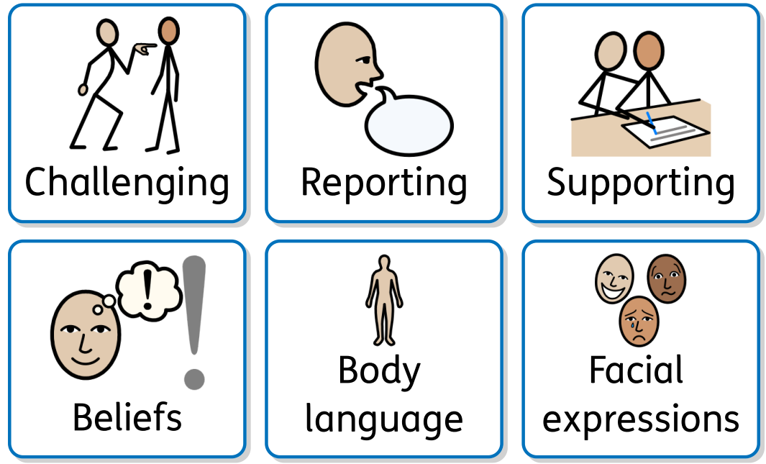
Handout: Being a positive bystander symbols (optional)
Widgit Symbols © Widgit Software 2002 - 2022
Being a positive bystander

Slide 5
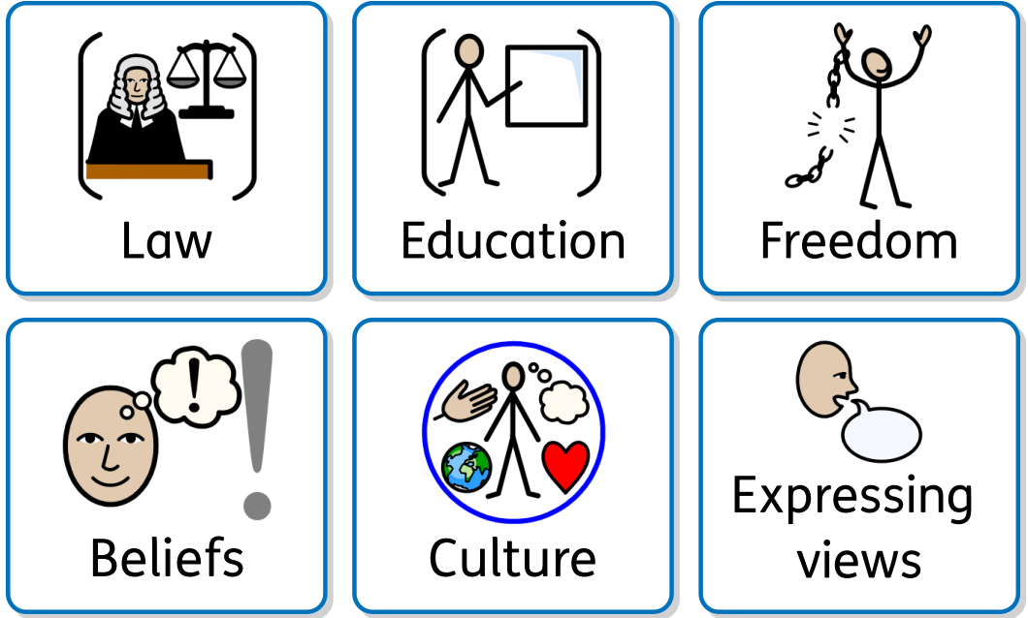
Handout: Rights in relationships symbols (optional)
Widgit Symbols © Widgit Software 2002 - 2022
Rights in relationships

Slide 6
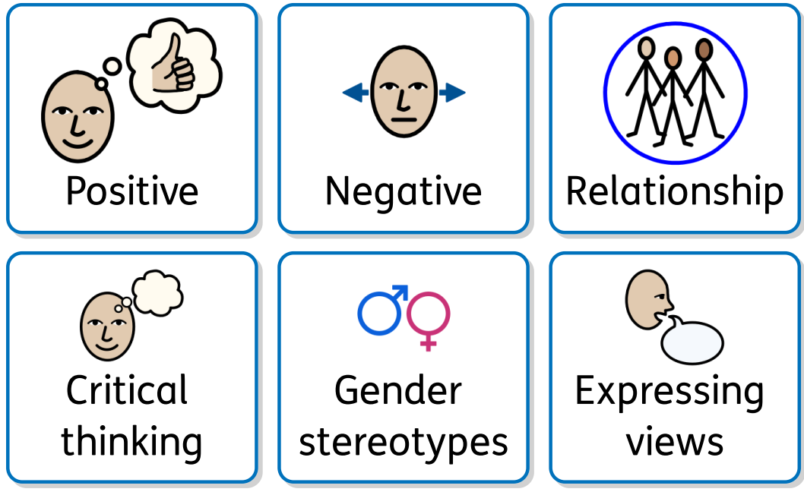
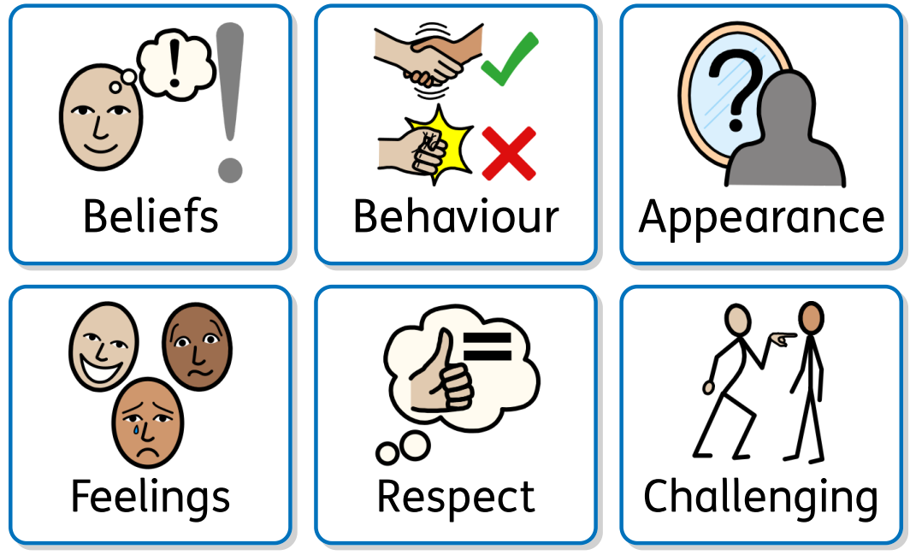
Handout: Gender stereotypes symbols (optional)
Widgit Symbols © Widgit Software 2002 - 2022
Gender stereotypes

Slide 7
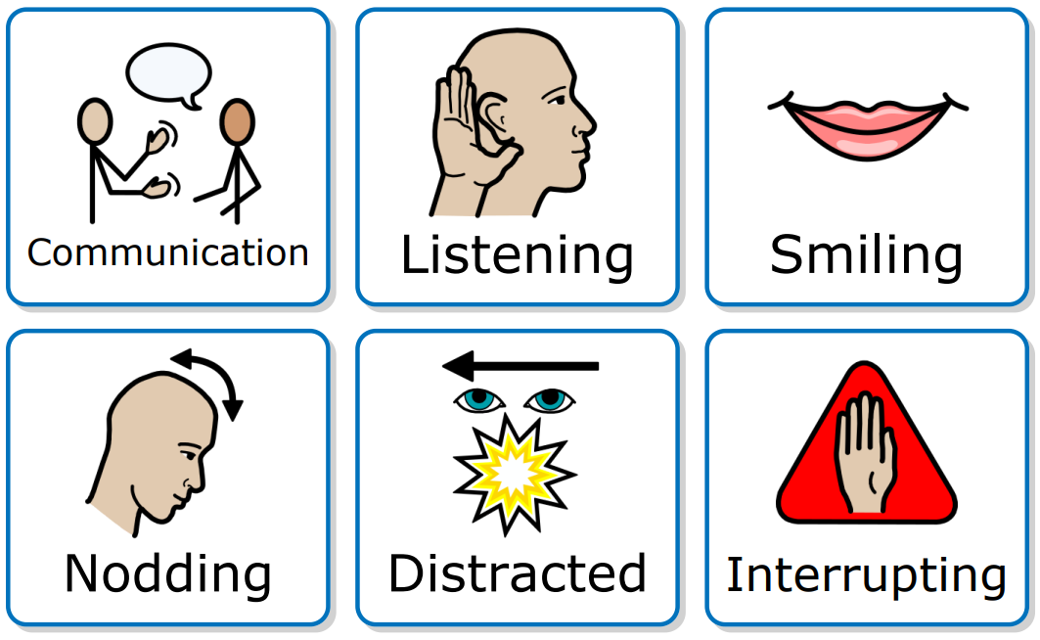
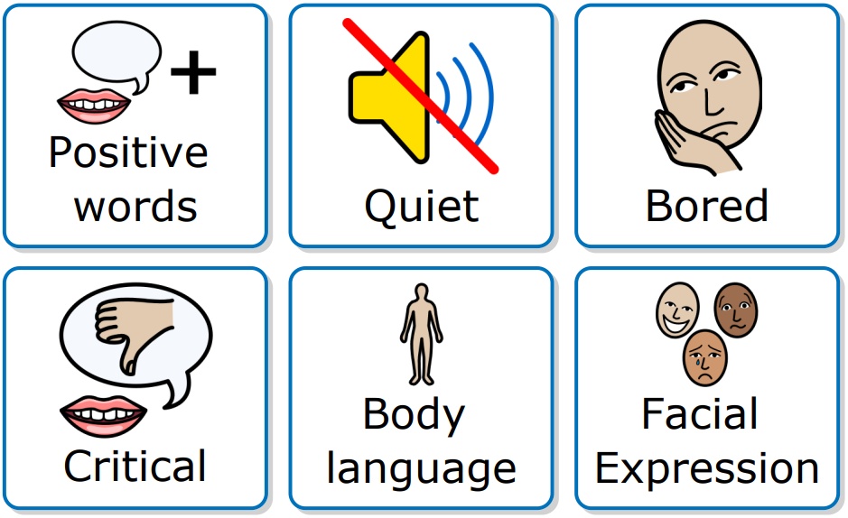
Handout: Good communication symbols (alternative activity)
Widgit Symbols © Widgit Software 2002 - 2022
Listening, understanding and communicating

Slide 8
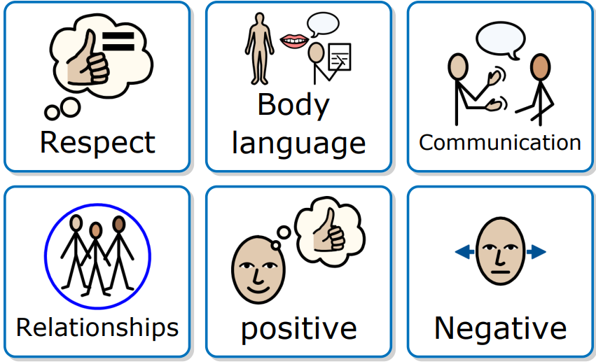
Handout: Listening, understanding and communicating symbols (optional)
Widgit Symbols © Widgit Software 2002 - 2022
Listening, understanding and communicating

Slide 9
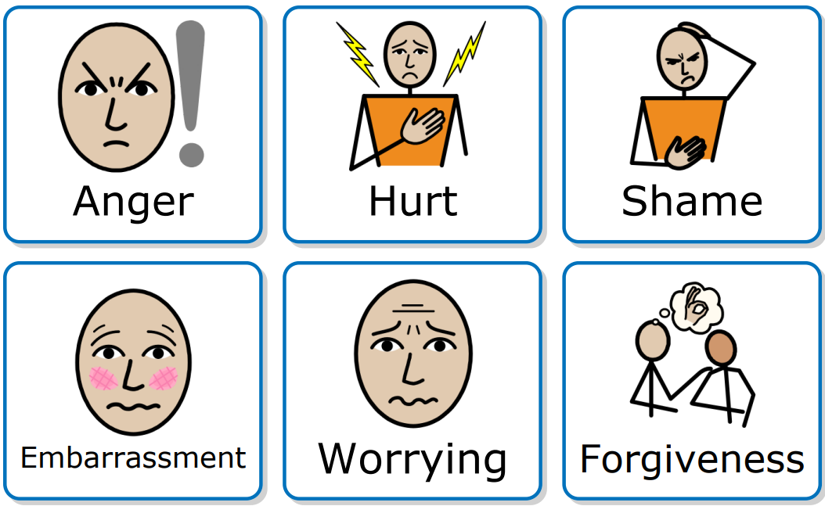
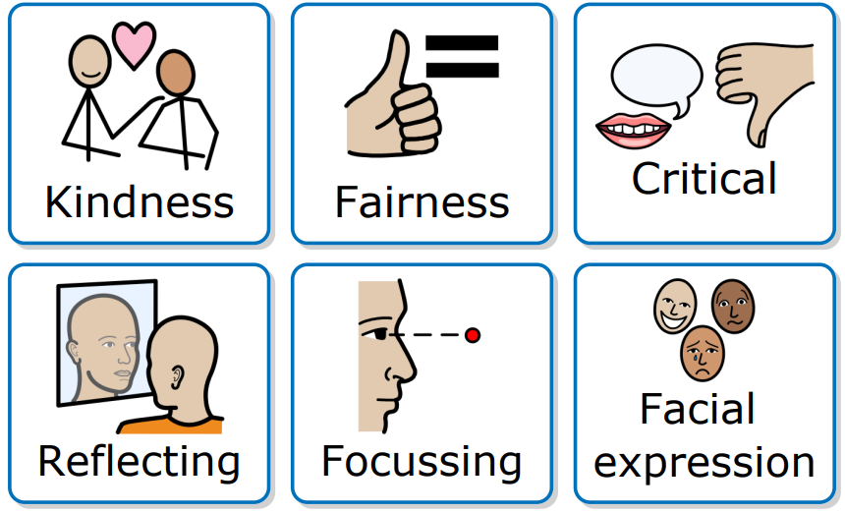
Handout: Listening, understanding and communicating symbols (optional)
Widgit Symbols © Widgit Software 2002 - 2022
Listening, understanding and communicating

Slide 10
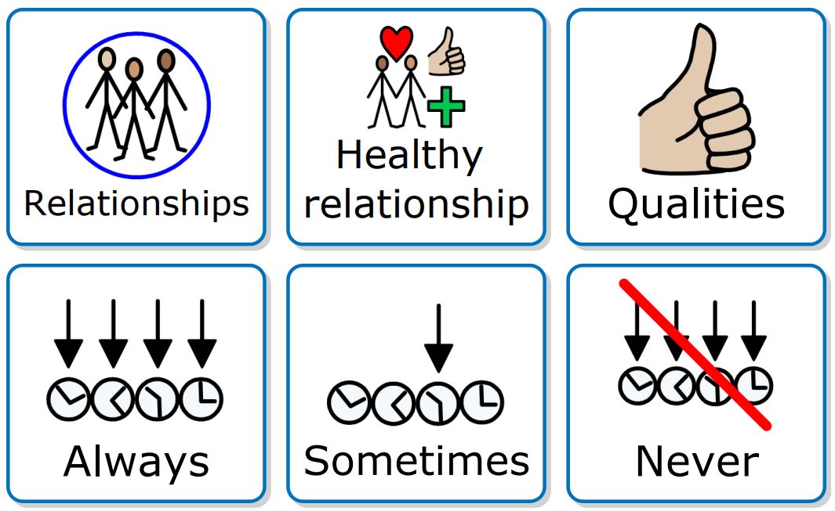
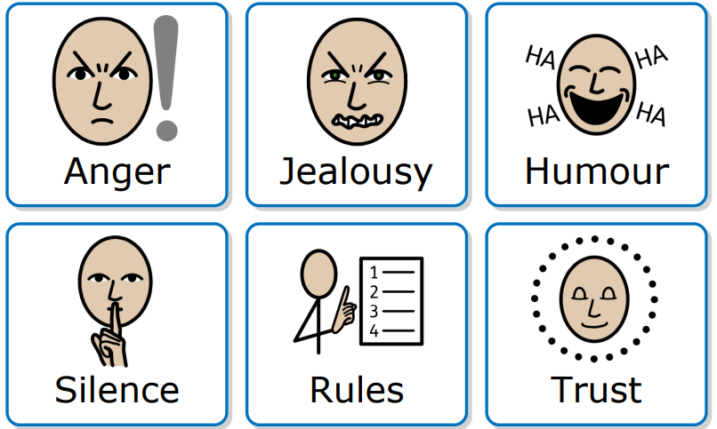
Handout: Relationship qualities symbols (alternative activity)
Widgit Symbols © Widgit Software 2002 - 2022
Principles of healthy relationships

Slide 11
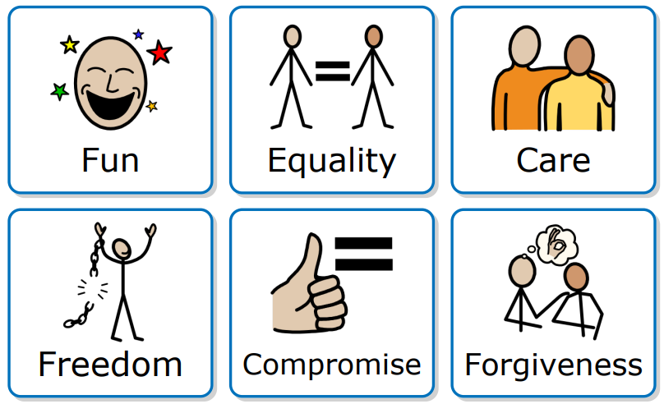
Handout: Relationship qualities symbols (alternative activity)
Widgit Symbols © Widgit Software 2002 - 2022
Principles of healthy relationships

Slide 12
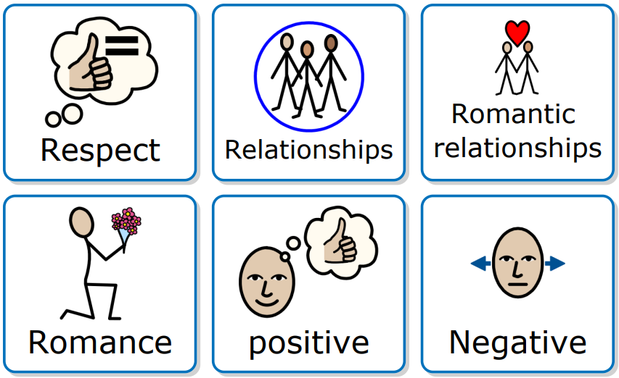
Handout: Principles of healthy relationships symbols (optional)
Widgit Symbols © Widgit Software 2002 - 2022
Principles of healthy relationships

Slide 13
Handout: Principles of healthy relationships symbols (optional)
Widgit Symbols © Widgit Software 2002 - 2022
Principles of healthy relationships

Slide 14
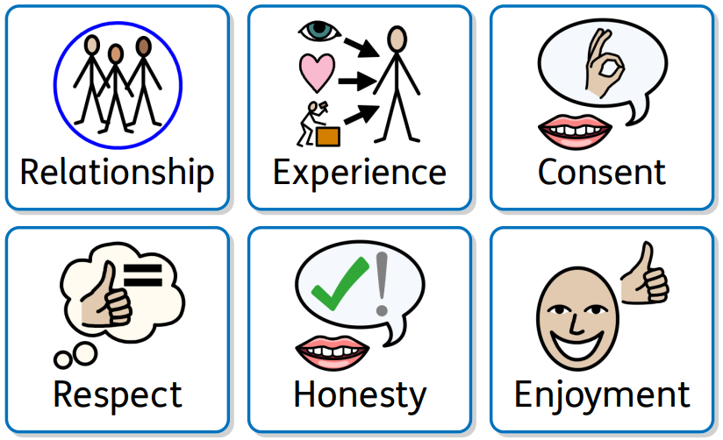
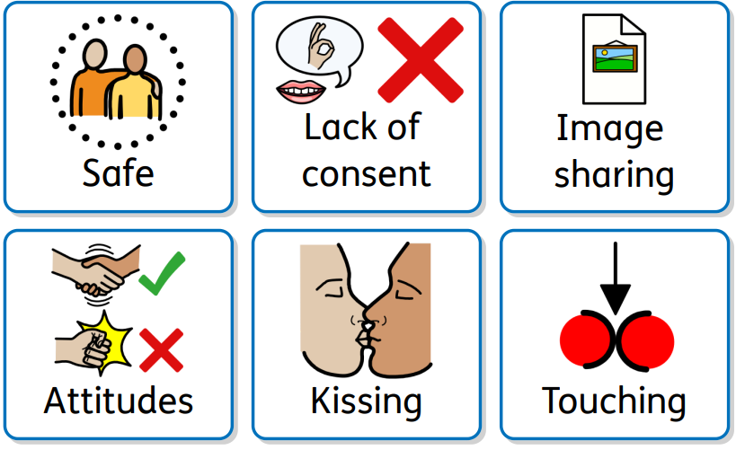
Handout: Principles of healthy sexual experiences symbols (optional)
Widgit Symbols © Widgit Software 2002 - 2022
Principles of healthy sexual experiences

Slide 15
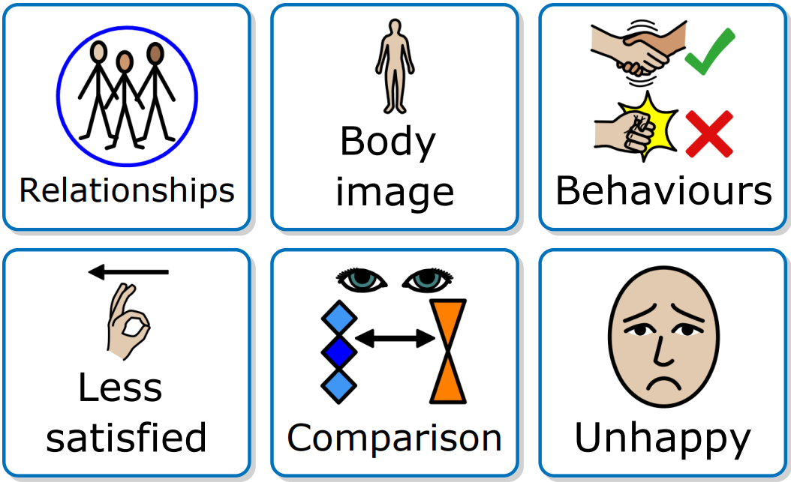
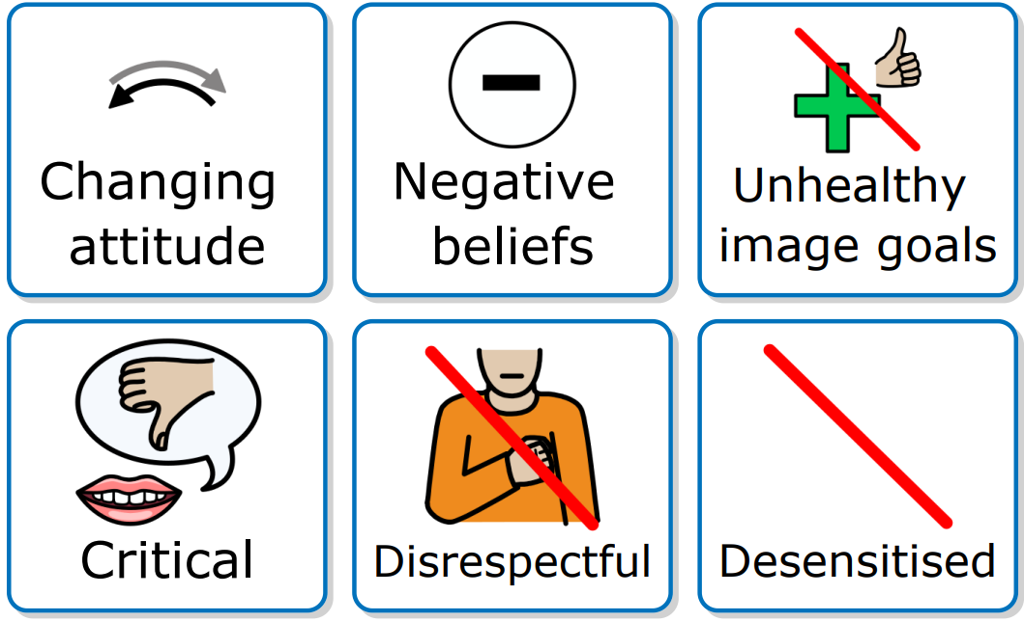
Handout: Impact symbols (alternative activity)
Widgit Symbols © Widgit Software 2002 - 2022
Sexual content online

Slide 16
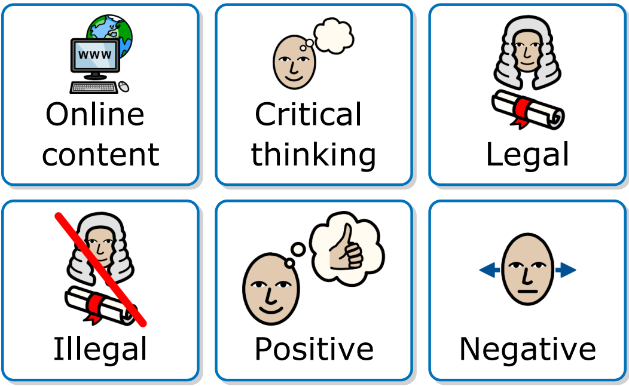
Handout: Sexual content online symbols (optional)
Widgit Symbols © Widgit Software 2002 - 2022
Sexual content online

Slide 17
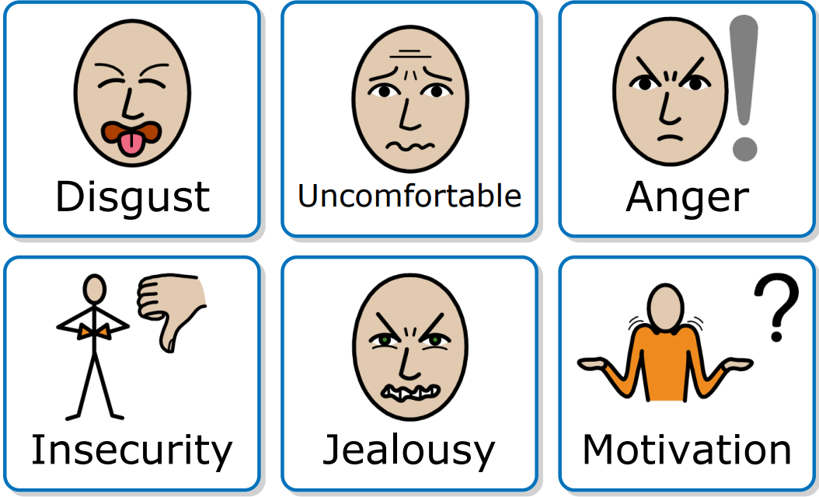
Handout: Sexual content online symbols (optional)
Widgit Symbols © Widgit Software 2002 - 2022
Sexual content online

